Slide 1
FPGA and CPLD
University Of Diyala
College Of Engineering
Computer Engineering Department
Dr. Yasir Amer Abbas
Third stage
2018

Slide 2
Problems Using SPLD

Slide 3
Advantages of FPGA & CPLDs

Slide 4
Advantages of FPGA & CPLDs

Slide 5
Advantages of FPGA & CPLDs

Slide 6
Advantages of FPGA & CPLDs

Slide 10
General CPLD Architecture

Slide 13
Xilinx CPLD Architecture

Slide 14
Macrocells

Slide 15
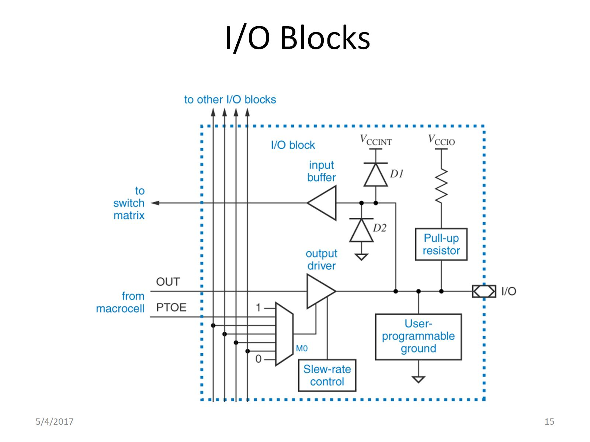
I/O Blocks

Slide 20
what does 'Field Programmable' mean?

Slide 21
FPGA

Slide 22
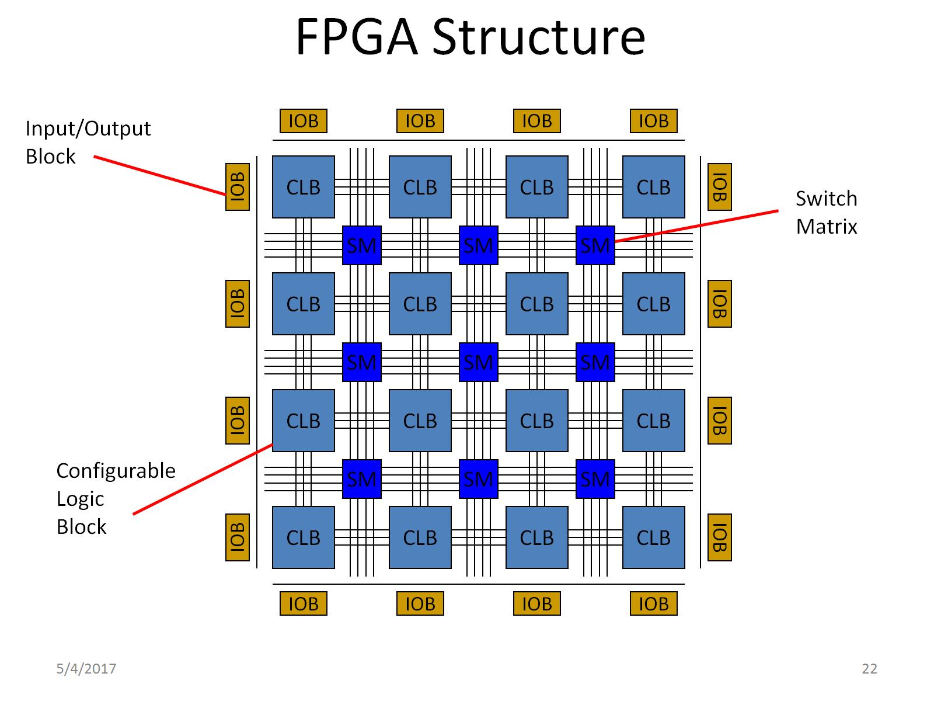
FPGA Structure

Slide 23
The structure of FPGA

Slide 24
1-Basic Logic block

Slide 25
Look-Up Tables (LUT)

Slide 26
multiplexers Implementation

Slide 27
2-Programmable Interconnect

Slide 28
2-Programmable Interconnect

Slide 29
Switch Matrix Operation

Slide 30
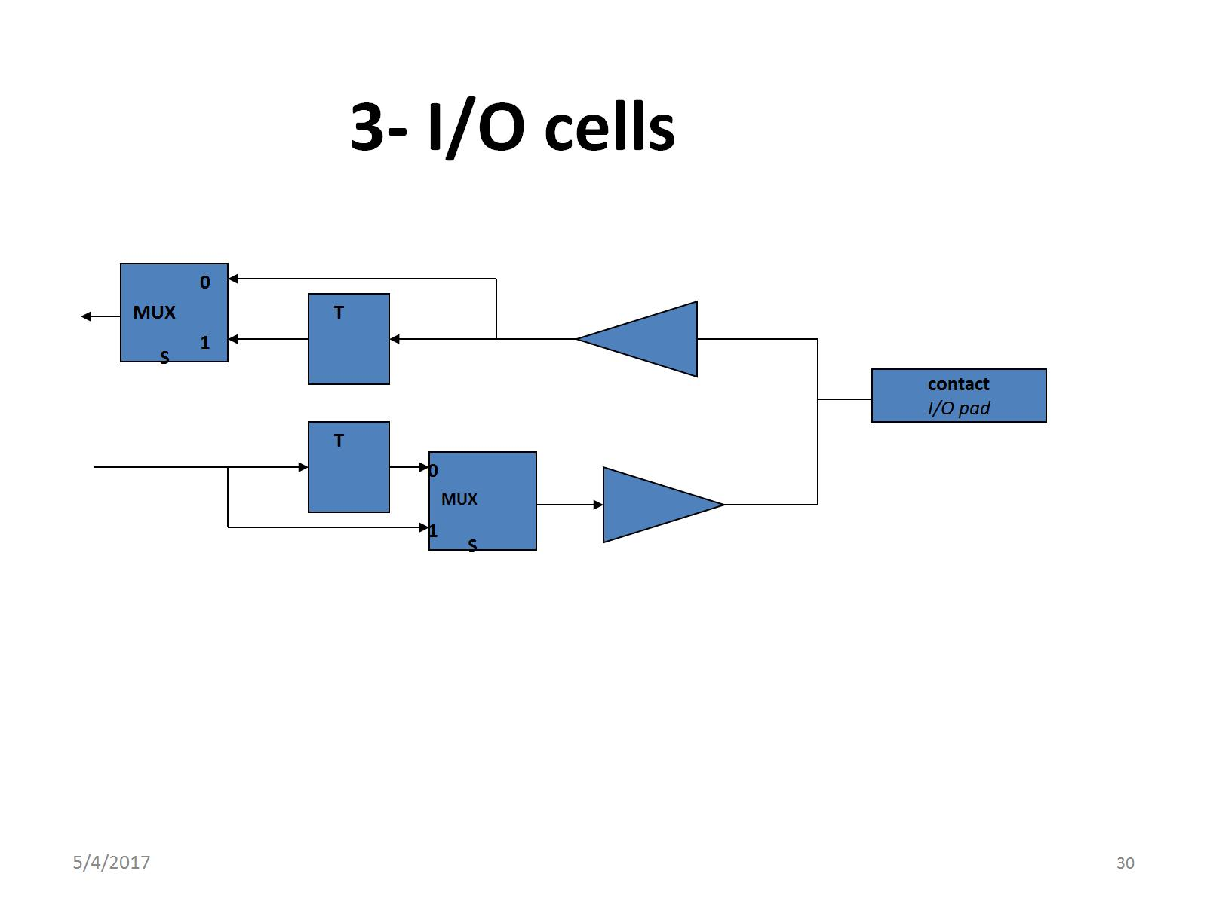
_{3- I/O cells}

Slide 31
Other FPGA Building Blocks

Slide 32
Configuration Storage Elements

Slide 33
FPGA Vendors & Device Families

Slide 34
Designing Logic with FPGAs

Slide 35
Graphical descriptions

Slide 36
What is HDL?

Slide 38
Shortly About the VHDL

Slide 39
Shortly About the Verilog

Slide 40
VHDL vs. Verilog

Slide 41
FPGA applications:-

